Slide 1
Earthquake prediction model using python

Slide 2
TEAM MEMBERS
RAMANA J (113321106074)
NITHIN R (113321106062)
PREM KUMAR J (113321106070)
SUJITHKUMAR S M (113321106097)
ROGEETH R (113321106077)

Slide 3
INTRODUCTION
Predicting earthquakes is a complex and challenging task due to the unpredictable nature of seismic events. While it's important to clarify that accurately predicting the exact time, location, and magnitude of an earthquake is still a major scientific challenge, we can build models that aim to forecast the likelihood of earthquakes in a certain region within a given timeframe. In this introduction, we'll outline how to create a basic earthquake prediction model using Python.
Earthquake prediction involves analyzing various geological and seismological factors to estimate the probability of seismic events in a specific region. Machine learning and data analysis techniques can be applied to historical earthquake data, geological features, and environmental factors to build predictive models.

Slide 4
OBJECTIVE
To develop a machine learning model in Python that utilizes historical earthquake data, geological features, and other relevant factors to predict the likelihood or risk of earthquakes occurring in a given geographical region within a specified timeframe.

Slide 5
Data collection
Collecting data for earthquake prediction is a fundamental step in building predictive models. However, it's important to note that earthquake prediction remains a highly challenging and largely unpredictable field. What's typically done is collecting historical seismic and geospatial data for analysis and creating models that can identify patterns or anomalies. Here's how you can collect relevant data:
1.*Seismic Data*: - Access historical seismic data, which includes information about past earthquakes. The USGS Earthquake Catalog and other seismic monitoring organizations provide such data. - You can use APIs or download datasets from their websites .
2. *Geospatial Data*: - Collect geospatial data that includes information about the Earth's crust, tectonic plate boundaries, fault lines, and geological features. - This data helps in understanding the geological context.

Slide 6
Data collection
3. *Sensor Data*: - If available, you can collect real-time sensor data from seismometers and other geological monitoring equipment. - These sensors provide information about ground motion and other seismic activity.
4. *Historical Records*: - Historical records and reports of past earthquakes in the region of interest can provide valuable insights.
5. *Satellite Imagery*: - Satellite imagery can be used to monitor ground deformation and changes in the Earth's surface, which may indicate stress buildup.
Dataset link : https://www.kaggle.com/datasets/usgs/earthquake-database

Slide 7
Data preprocessing
Data preprocessing is a crucial step in preparing your earthquake-related data for predictive modeling. Here are some common data preprocessing steps you can follow for earthquake prediction
1. *Data Cleaning*: - Handle missing data: Identify and deal with missing values in your dataset. Depending on the amount of missing data, you can either remove rows with missing values or impute missing values using methods like mean, median, or advanced imputation techniques.
2. *Feature Engineering*: - Create relevant features: Engineer new features that might be informative for earthquake prediction. For example, you can calculate earthquake frequency in a region, historical earthquake activity, or distance to fault lines.

Slide 8
Data Preprocessing
3. *Normalization and Scaling*: - Normalize or scale numerical features to bring them to a similar scale. This is important for algorithms that are sensitive to feature scales, such as gradient-based methods.
4. *Data Encoding*: - Convert categorical variables into numerical format using techniques like one-hot encoding or label encoding, if applicable.
5. *Data Scaling*: - Scale numerical features to a common range (e.g., 0 to 1) using techniques like Min-Max scaling or standardization.

Slide 9
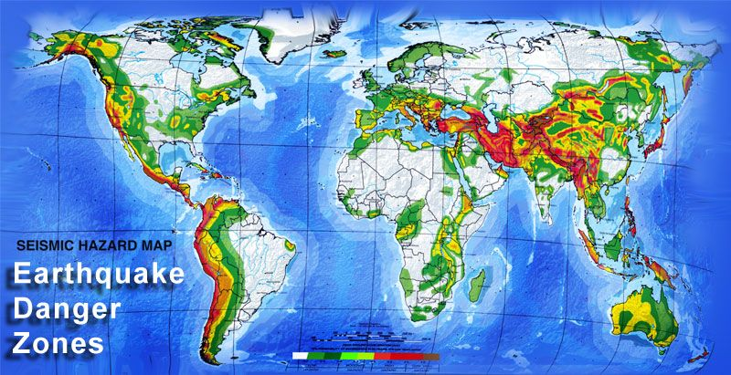
world map earthquake frequency distribution.

Slide 10
Conclusion
In conclusion, earthquake prediction is a complex and challenging field that involves the study of seismic data, geospatial information, and geological processes to anticipate the occurrence of earthquakes. While significant progress has been made in earthquake research, several key points should be noted
In essence, while the dream of precise earthquake prediction remains elusive, advancements in monitoring, modeling, and preparedness have improved our ability to mitigate earthquake risks and protect lives and infrastructure. The focus in earthquake research has shifted toward reducing vulnerability, enhancing early warning systems, and fostering public awareness to ensure safety in earthquake-prone regions.

Slide 11
THANK YOU !!!

